Slide 1

TRAVEL
PRESENTED BY
Shashikiran Y
Kiran karkali
Dhananjay Kumar Rathod
Pradyumna .S

Slide 2
Some people may not be able or willing to spend much money, but wish to see the world anyhow. It is possible to travel with very little or even no money at all. This means either keeping expenses low or earning money while one travels. Important: in your quest to reduce expenses, do not steal or mooch from others. There is honor in ultra-budget travel
About us

Slide 3
save
To really stretch your budget, here are some money-saving tips: In places where drinking bottled water is necessary, buy the biggest bottle of drinking water you can find in the local supermarket. Leave it at your place of accommodation, and use it to refill a smaller bottle you carry around with you. That way you can save through bulk purchase and reduce waste. Or boil your water and use it to refill bottles. Travel slowly. Staying in the same location several weeks or months reduces transportation costs and gives you time to determine the cheapest places to stay (you can usually negotiate lower rates for extended stays), eat and visit. Rushing around compounds costs. Join a group tour - often there are significant group discounts and you can visit places that would be far more expensive if you visited on your own. Do your own laundry. Each night, wash your socks and underwear in the hostel sink. Bring

Slide 4
a universal sink stopper for this. Then wring out your garments and roll them up in a towel to prevent dripping. String a cord through the slats of the upper bunk of the hostel bunkbed, and hang your clothes to dry. By morning (or the following evening, depending on the climate), they should be ready. Travel only with quick-dry clothes. Bear in mind that some hostels frown on people doing this, preferring that guests use their overpriced laundry services, so keep it on the downlow, clean up your messes, and don't let your clothes drip on anything. Buy the local currency before you travel, don't exchange your currency at the airport or at street stands. Another way to save money is calculate or evaluate your travel budget before to leave. Know your future budget helps more than do not know the cost of living of the country you are traveling in. There is a website helping you for this, Tool You can adjust your budget with your traveler profile (backpacker, tourist, comfortable..

Slide 5
all about travelling
Travel is the movement of people between distant geographical locations. Travel can be done by foot, bicycle, automobile, train, boat, bus, airplane, ship or other means, with or without luggage, and can be one way or round trip. Travel can also include relatively short stays between successive movements, as in the case of tourism .

Slide 6
Front End
HTML
CSS
Back End
Google spread sheet
App script

Slide 7
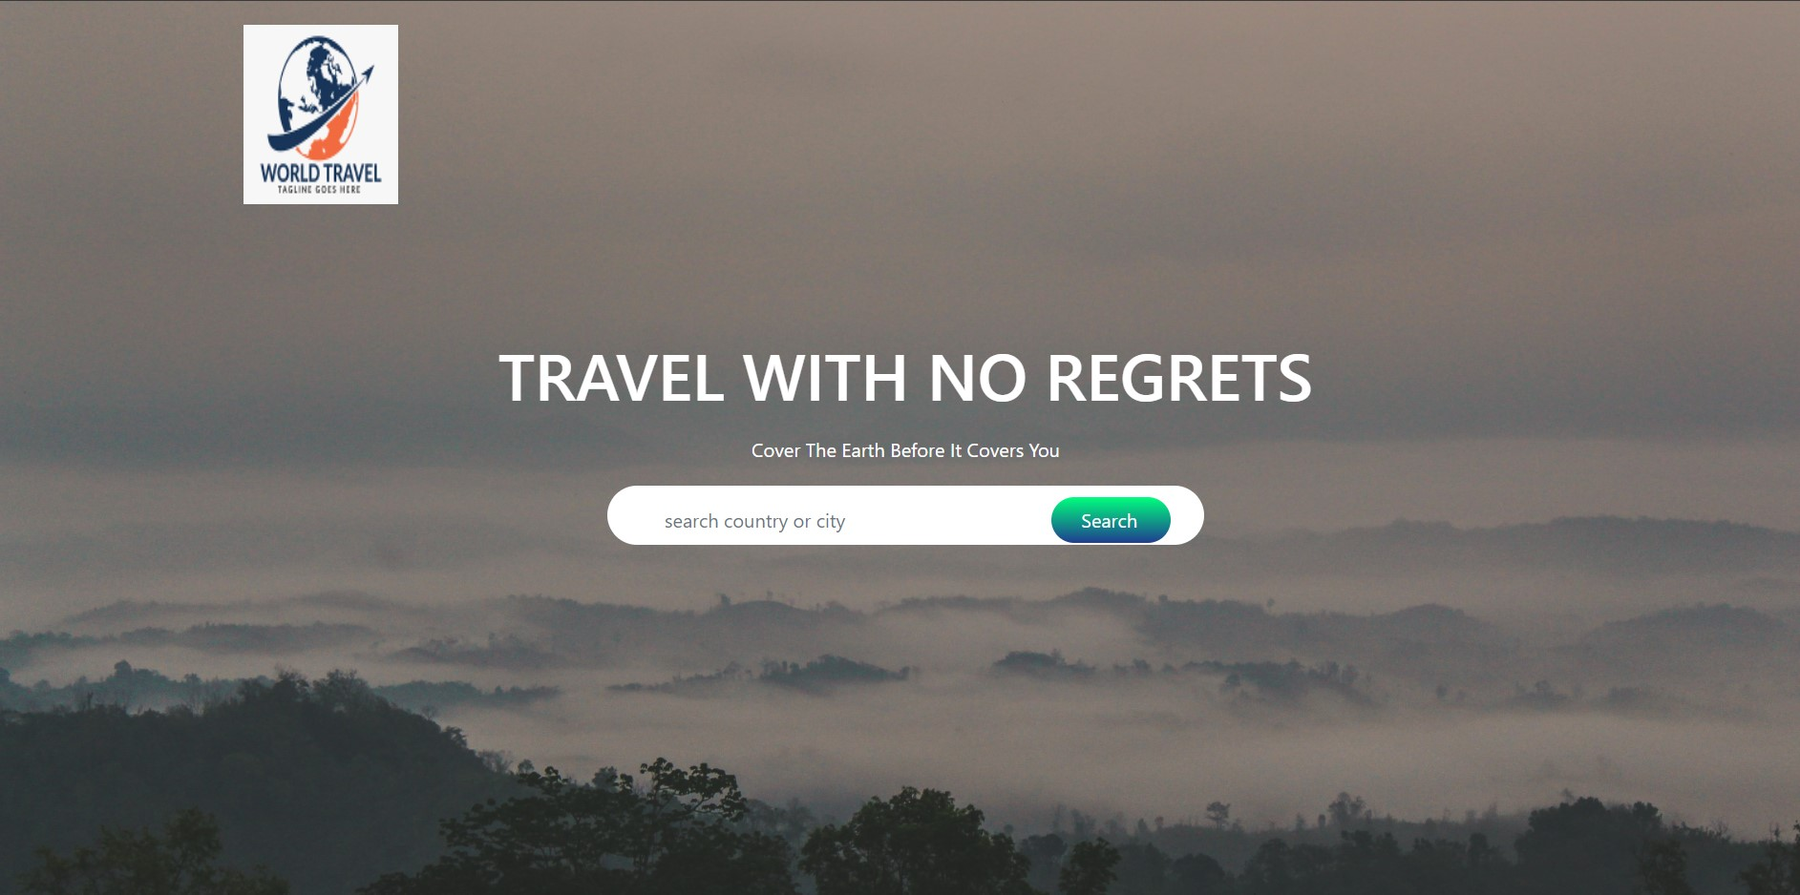

Slide 8
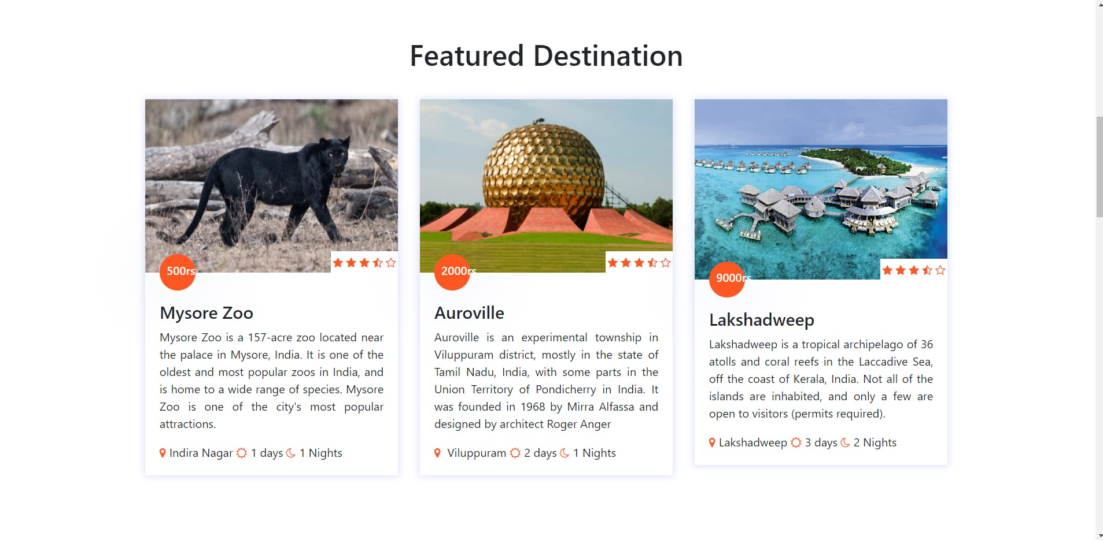

Slide 9
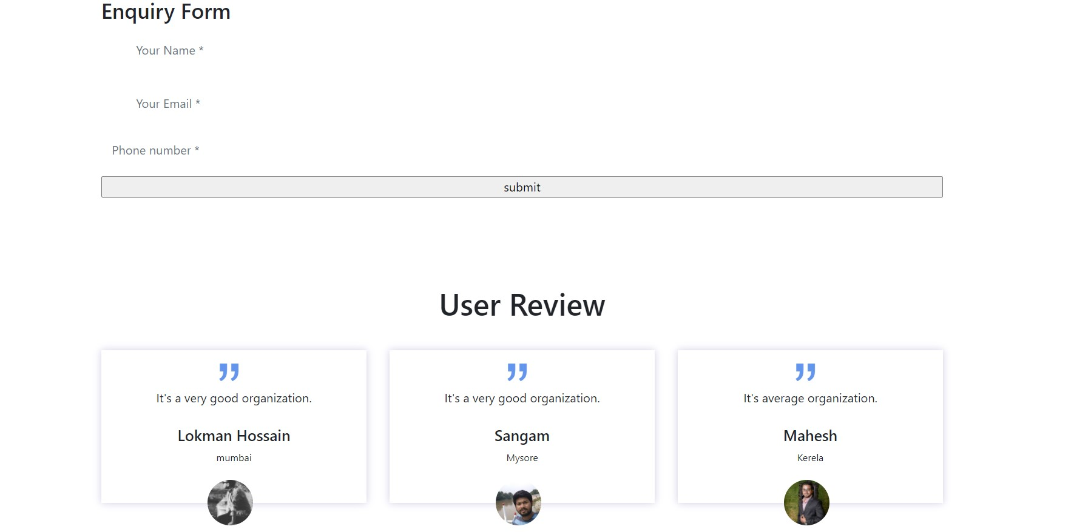

Slide 10
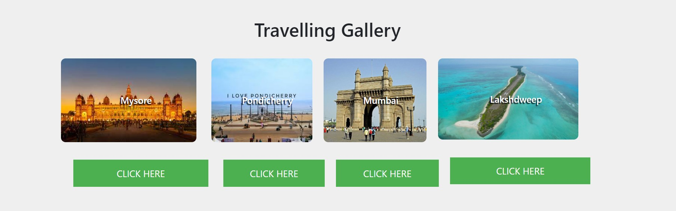

Slide 11


